Slide 1
Deep Learning (CS324)
6. Recurrent Neural Networks* (Continued)
Jianguo Zhang
SUSTech
*Based on http://www.deeplearningbook.org chapter 10 + sources mentioned in slides

Slide 2
RNN
Gated Recurrent Neural Network
Different architectures of RNN.

Slide 3
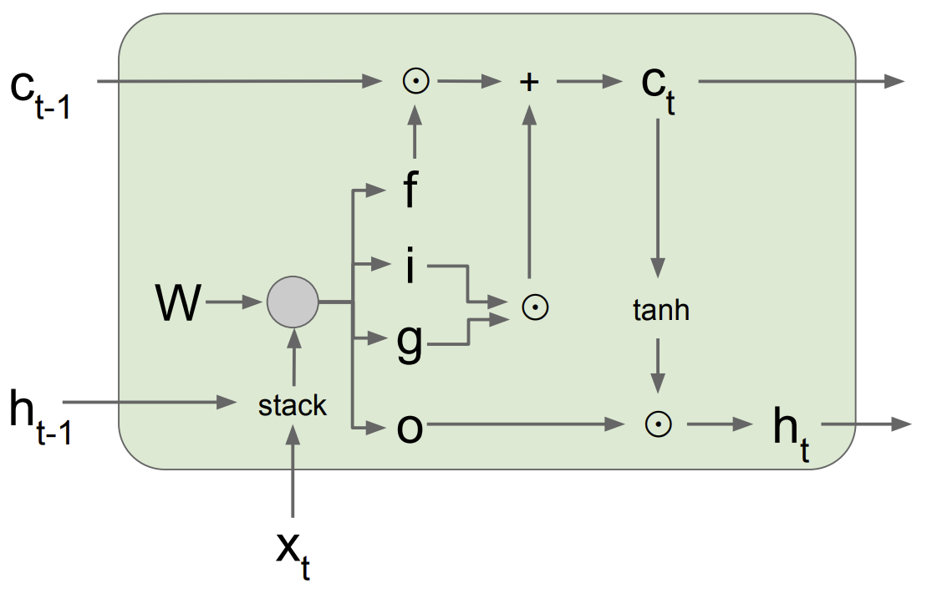
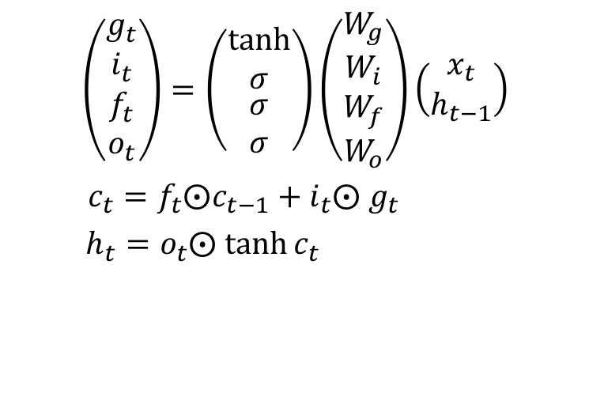
LSTM Forward Pass Summary
$$\left(\begin{matrix}g_{t} \\ i_{t} \\ \begin{aligned}f_{t} \\ o_{t}\end{aligned}\end{matrix}\right)=\left(\begin{matrix}tanh \\ σ \\ \begin{aligned}σ \\ σ\end{aligned}\end{matrix}\right)\left(\begin{matrix}W_{g} \\ W_{i} \\ \begin{aligned}W_{f} \\ W_{o}\end{aligned}\end{matrix}\right)\left(\begin{aligned}x_{t} \\ h_{t−1}\end{aligned}\right)$$
$c_{t}={f_{t}⨀c}_{t−1}+i_{t}⨀ g_{t}$
$h_{t}=o_{t}⨀ tanh⁡c_{t}$
Figure source

Slide 4
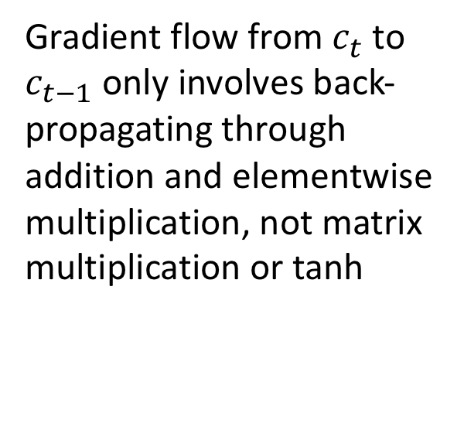
LSTM Backward Pass
Gradient flow from $c_{t}$ to $c_{t−1}$ only involves back-propagating through addition and elementwise multiplication, not matrix multiplication or tanh
For complete details: Illustrated LSTM Forward and Backward Pass
Figure source

Slide 5
Gated Recurrent Unit (GRU)
x_{t} h_{t-1}
Update Gate
z_{t}
W_{z}
Get rid of separate cell state
Merge “forget” and “output” gates into “update” gate
x_{t}
W
h’_{t}
.
h_{t}
h_{t-1}
r_{t}
Reset Gate
W_{f}
x_{t} h_{t-1}
K. Cho, B. Van Merrienboer, C. Gulcehre, D. Bahdanau, F. Bougares, H. Schwenk, and Y. Bengio, Learning phrase representations using RNN encoder-decoder for statistical machine translation, ACL 2014

Slide 6

Gated Recurrent Unit (GRU)
x_{t}
W
$$h_{t}=\tanh{W}\left(\begin{aligned}x_{t} \\ h_{t−1}\end{aligned}\right)$$
h_{t}
h_{t-1}

Slide 7


Gated Recurrent Unit (GRU)
$$r_{t}=σ\left(W_{r}\left(\begin{aligned}x_{t} \\ h_{t−1}\end{aligned}\right)+b_{t}\right)$$
x_{t}
W
$$h_{t}^{′}=\tanh{W}\left(\begin{aligned}x_{t} \\ r_{t} ⨀{ h}_{t−1}\end{aligned}\right)$$
h’_{t}
.
h_{t-1}
r_{t}
Reset Gate
W_{f}
x_{t} h_{t-1}

Slide 8

Gated Recurrent Unit (GRU)
x_{t} h_{t-1}
Update Gate
z_{t}
W_{z}
$$r_{t}=σ\left(W_{r}\left(\begin{aligned}x_{t} \\ h_{t−1}\end{aligned}\right)+b_{t}\right)$$
x_{t}
W
$$h_{t}^{′}=\tanh{W}\left(\begin{aligned}x_{t} \\ r_{t} ⨀{ h}_{t−1}\end{aligned}\right)$$
h’_{t}
.
h_{t-1}
$$z_{t}=σ\left(W_{z}\left(\begin{aligned}x_{t} \\ h_{t−1}\end{aligned}\right)+b_{z}\right)$$
r_{t}
Reset Gate
W_{f}
x_{t} h_{t-1}

Slide 9

Gated Recurrent Unit (GRU)
x_{t} h_{t-1}
Update Gate
z_{t}
W_{z}
$$r_{t}=σ\left(W_{r}\left(\begin{aligned}x_{t} \\ h_{t−1}\end{aligned}\right)+b_{t}\right)$$
x_{t}
W
$$h_{t}^{′}=\tanh{W}\left(\begin{aligned}x_{t} \\ r_{t} ⨀{ h}_{t−1}\end{aligned}\right)$$
h’_{t}
.
h_{t}
h_{t-1}
$$z_{t}=σ\left(W_{z}\left(\begin{aligned}x_{t} \\ h_{t−1}\end{aligned}\right)+b_{z}\right)$$
r_{t}
Reset Gate
W_{f}
$h_{t}=\left(1−z_{t}\right) ⨀{ h}_{t−1}+z_{t}⨀$ $h_{t}^{′}$
x_{t} h_{t-1}

Slide 10
Multi-layer RNNs
We can of course design RNNs with multiple hidden layers
y₁
y₂
y₃
y₄
y₅
y₆
x₁
x₂
x₃
x₄
x₅
x₆
Anything goes: skip connections across layers, across time, …

Slide 11
Bi-directional RNNs
RNNs can process the input sequence in forward and in the reverse direction
y₁
y₂
y₃
y₄
y₅
y₆
x₁
x₂
x₃
x₄
x₅
x₆
Popular in speech recognition

Slide 12
Use Cases
Multiple input – Single output
Sequence Classification
Single - Multiple
Image Captioning
Multiple - Multiple
Image Captioning
Multiple - Multiple
Translation

Slide 13


Sequence Classification
Ignore
Ignore
Linear Classifier
h₁
h₂
h_{n}
RNN
RNN
RNN
h₁
h₂
h_{n-1}
The
food
good

Slide 14
Sequence Classification
Linear Classifier
h = Sum(…)
h₁
h_{n}
h₂
RNN
RNN
RNN
h₁
h₂
h_{n-1}
The
food
good
http://deeplearning.net/tutorial/lstm.html

Slide 15
Sequence Classification
Linear Classifier
h = Sum(…)
h₁
h_{n}
h₂
Bi-RNN
Bi-RNN
Bi-RNN
h₁
h₂
h_{n-1}
The
food
good

Slide 16
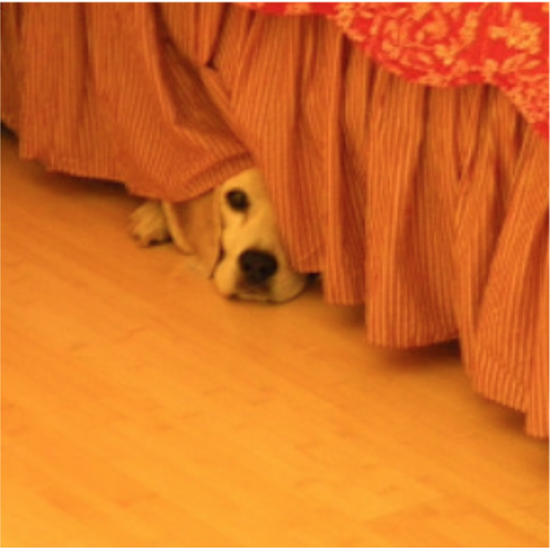
Image Caption Generation
“The”
“dog”
“is”
“hiding”
“STOP”
Classifier
Classifier
Classifier
Classifier
Classifier
h₁
h₂
h₃
h₄
h₅
h₀
h₁
h₂
h₃
h₄
CNN
“START”
“The”
“dog”
“is”
“hiding”

Slide 17
It’s raining LSTMs
There exist countless variations of LSTMs, with different researchers proposing different arrangements of the LSTM units
So, which one is better?
None: https://arxiv.org/pdf/1503.04069.pdf
Also, RNNs can outperform both LSTMs and GRUs: http://proceedings.mlr.press/v37/jozefowicz15.pdf

Slide 18
A Zoo of RNNs
If you are interested in the details for the following topics:
Bidirectional RNNs (Sec. 10.3 book)
Teacher forcing (Fig. 10.6 book)
Image captioning RNNs (Fig. 10.9 book)
Encoder-decoder architectures (Sec. 10.4 book)
…

Slide 19
Online resources
Music composition: http://www.hexahedria.com/2015/08/03/composing-music-with-recurrent-neural-networks/
Characters prediction: https://cs.stanford.edu/people/karpathy/recurrentjs/
Transformer networks: https://ai.googleblog.com/2017/08/transformer-novel-neural-network.html
RNN-Ts on your phone: https://ai.googleblog.com/2019/03/an-all-neural-on-device-speech.html

Slide 20
Summary
Sequential data and temporal dependances
Recurrent Neural Network and BPTT
Long Short-Term Memory
Gated Recurrent Unit
Different application cases of RNN

